Slide 1
Principles of Data Science
Li Niu

Slide 2
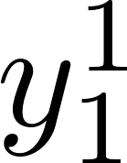
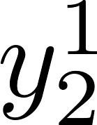
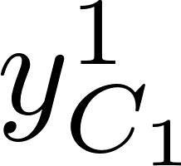

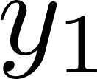
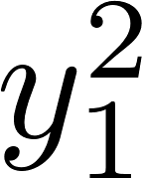
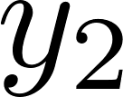
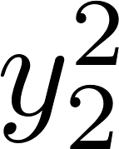

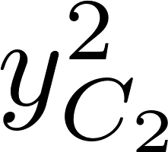
Single-task V.S. Multi-task
task1
…
…
task2
…
single-task learning
multi-task learning

Slide 3
Single-task V.S. Multi-task
task1
…
…
task2
…
single-task learning
multi-task learning

Slide 4
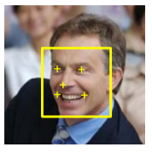
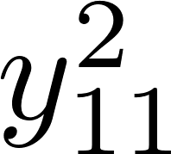
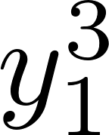
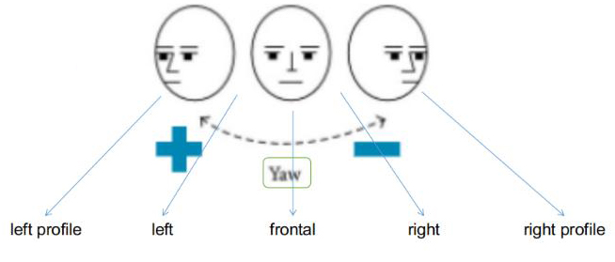
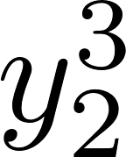
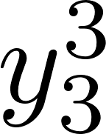
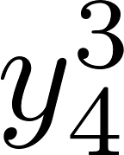
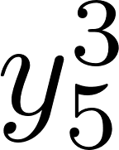
Multi-task learning
male
task 1: gender recognition
female
0-10
10-20
…
task2: age estimation
>100
left profile
left
frontal
task3: pose estimation
right
right profile

Slide 5


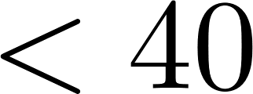

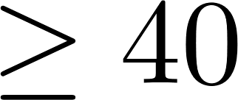
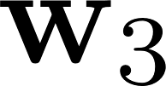
Traditional multi-task learning
Traditional methods for multi-task learning mainly focus on binary classification,
in which case the t-th task corresponds to one classifier
male
task 1: gender recognition
female
task2: age estimation
profile
task3: pose estimation
frontal

Slide 6



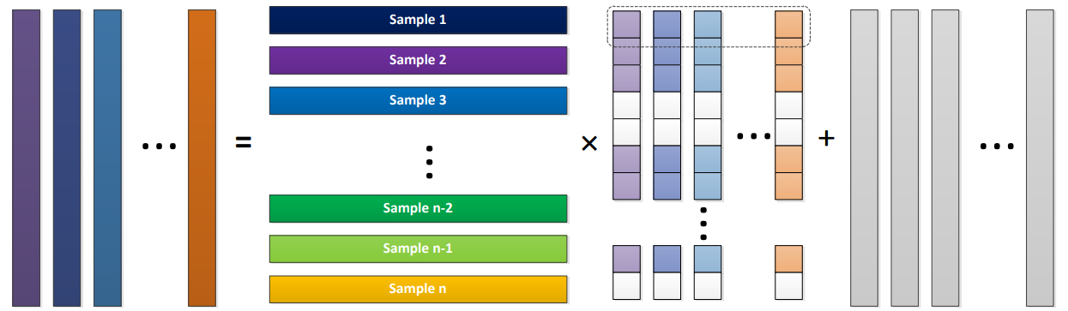
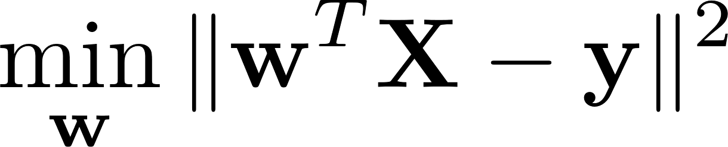
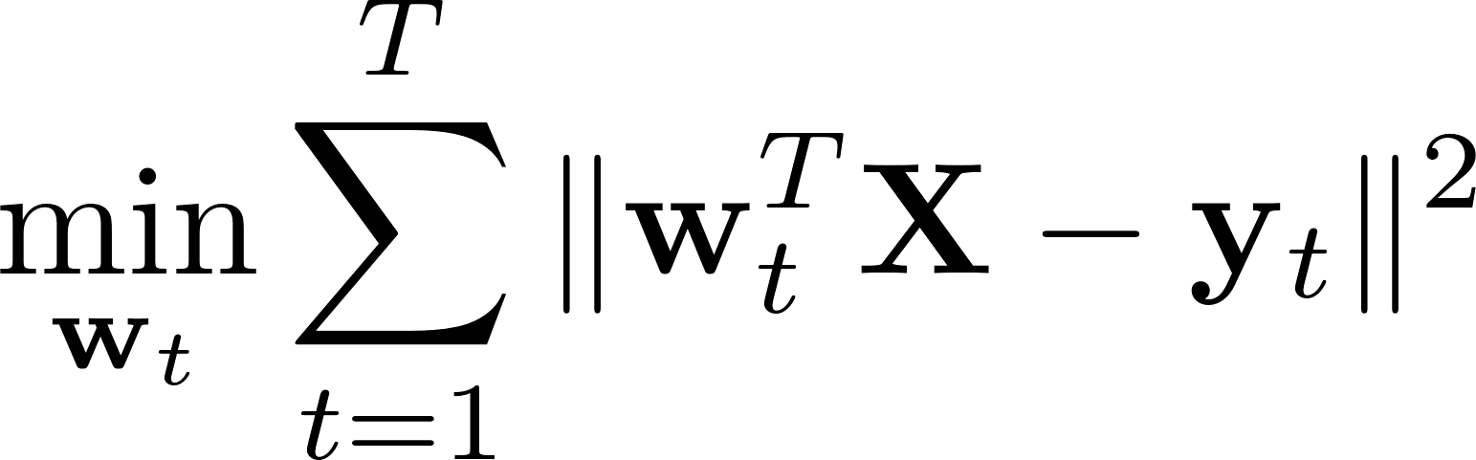
Traditional multi-task learning
task 1
task 2
task 3
task T
task 1
task 2
task 3
task T
single-task learning
multi-task learning

Slide 7
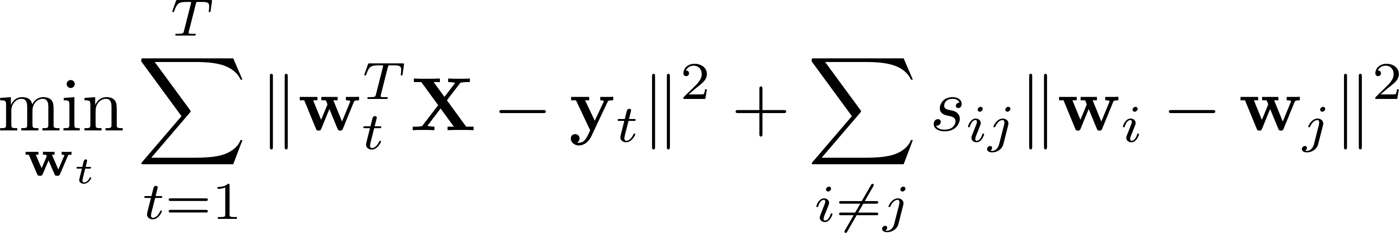
Traditional multi-task learning
consider task relationship
similarity among different tasks

Slide 8
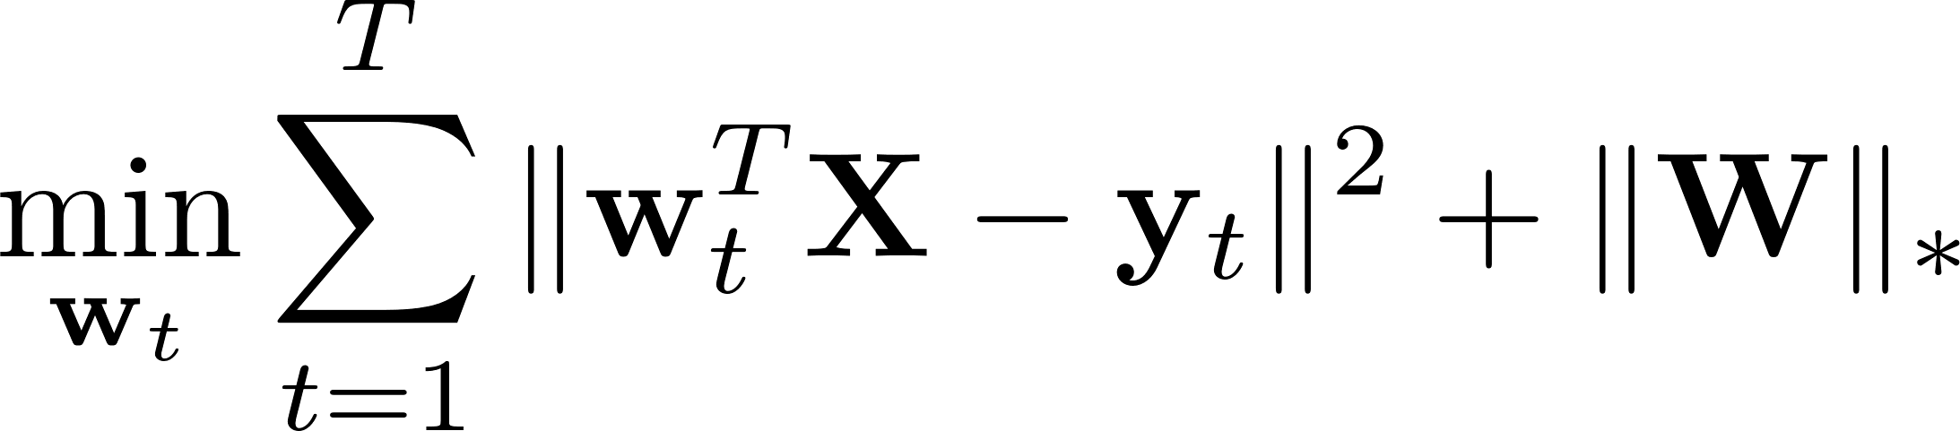
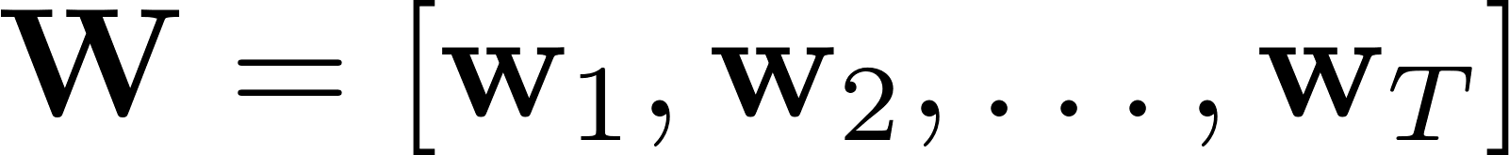
Traditional multi-task learning
consider low-rank property
nuclear norm

Slide 9
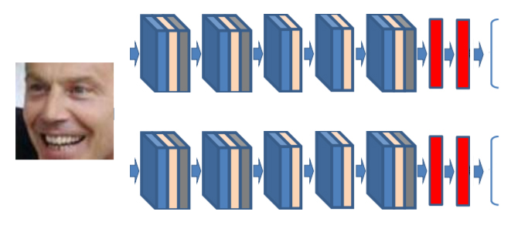
Deep multi-task learning
Task A
male
female
left
frontal
right
Task B

Slide 10
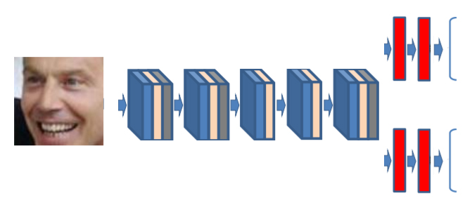
Deep multi-task learning
shared feature space
Task A
male
female
left
frontal
right
Task B

Slide 11
Deep multi-task learning
cross-stitch
Task A
male
female
left
frontal
right
Task B

Slide 12
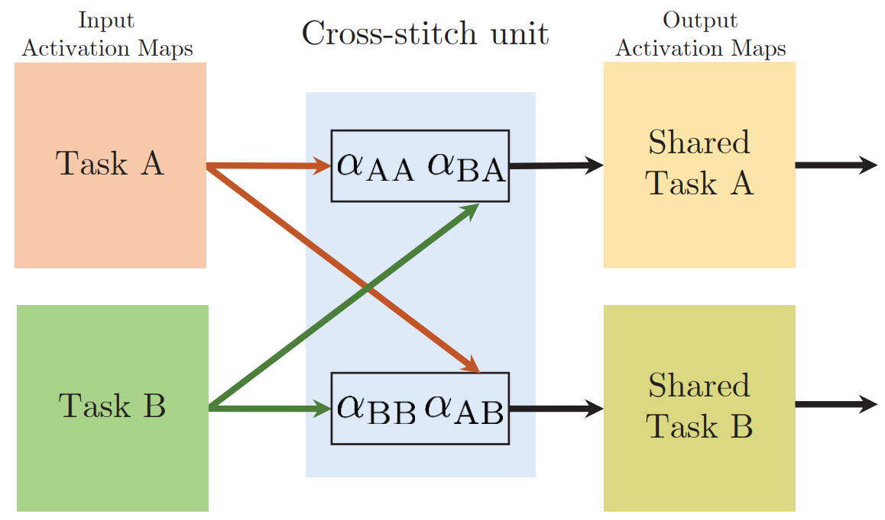

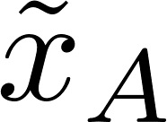

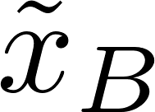
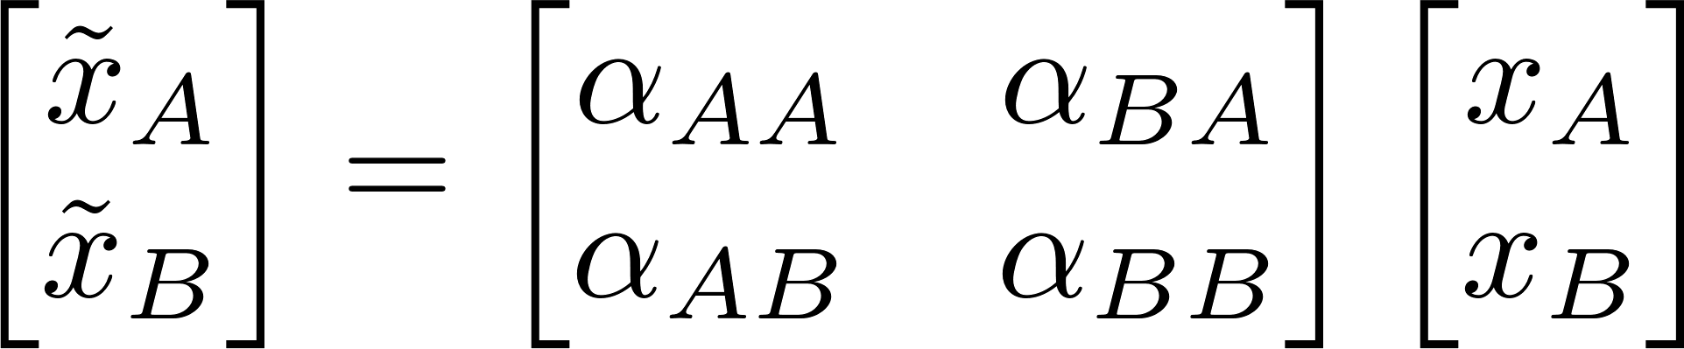
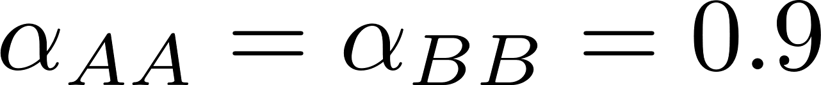
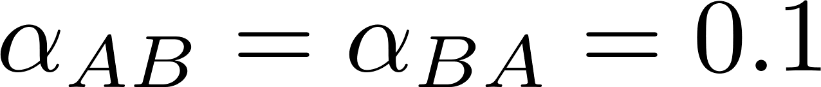
Deep multi-task learning
Initialize
are learnable parameters.

Slide 13
Multi-task multi-label learning
task1
task1
…
…
task2
task2
…
…
…
multi-task learning
multi-label learning
multi-task multi-label learning

Slide 14
Thanks!

